Slide 1
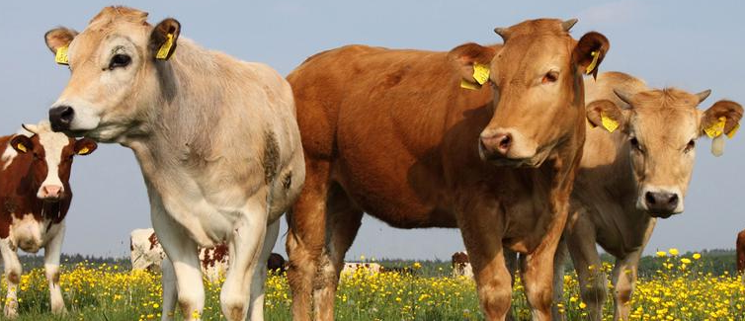
The existing and future role of RFID technology in Dairy Supply Chain from
Farm to Fork
Shuhab-u-Tariq
Aston Business School, UK
Candidate ID: 389552

Slide 2

Agenda
Introduction
Need for an end to end RFID food-traceability system | Why this topic?
Methodology
Risk Mitigation
Project Plan
Project Deliverables
Success Criteria
Ethical Issues
Conclusion

Slide 3
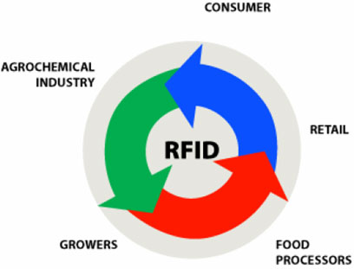
Introduction
Food safety concerns are on a rise and so is the management cost of food traceability systems
Aim is to trace the journey of food products right from the farm to the consumer’s plate
Topic being broad, this project will narrow it down to “Dairy Supply Chain”
Interestingly, not much research
has been done in this area

Slide 4

Need for an end to end RFID food-traceability system
An extra layer of protection when a food borne illness occurs
Better help investigate the root cause to any sort of food related concern
To provide efficient & accurate ways to comply with regulations such as the European Food Law, etc.
Helps prevent errors in order picking and shipping that plague the food industry

Slide 5
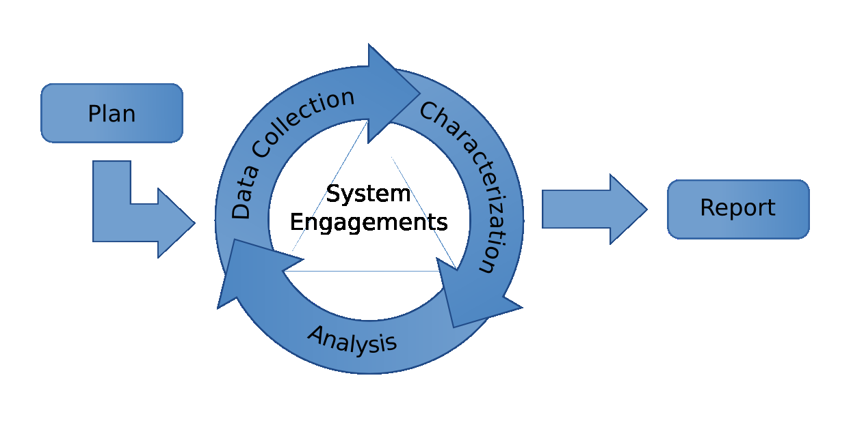
Methodology
Desktop Research
  University Library
  Trade Magazines
  Case Studies
  Videos & Other materials
Once all the resources are tapped into and enough information has been gathered, it will be analyzed so as to fulfill the aim of the project.

Slide 6
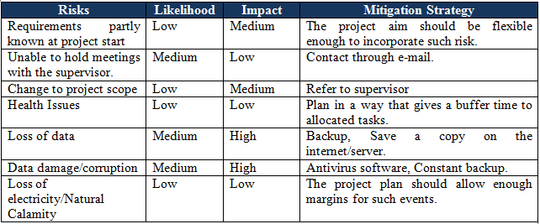
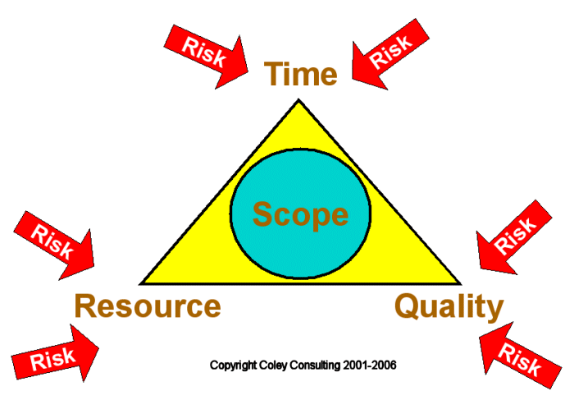
Risk Mitigation

Slide 7

Project Plan
Keeping in mind all the risk and other factors, this project is planned according to the following stages:
Stage 1: Overview of the project process (April-May)
Stage 2: Topic Selection (May)
Stage 3: Project Proposal (May)
Stage 4: Literature Review (June)
Stage 5: Research and Analysis (June-July)
Stage 6: First draft of the dissertation (August)
Stage 7: Submission (September)

Slide 8

Project Deliverables
A profound report on investment and technical issues related to RFID
Outline of integrated large-scale traceability system across the dairy supply chain.
Study of entire dairy supply chain to identify the gaps
Assessment of future of RFID in European countries
Explore potential innovations in this area
Business Opportunity in usage of RFID

Slide 9

Success Criteria
Since there is no client involved, if the aims of this report are met, the project can be considered successful
Outline of the traceability system
Discover innovative use of RFID
All other aims and deliverables, as already discussed

Slide 10

Ethical Issues
RFID gives confidence to stakeholders that the system is sustainable and ethical
RFID satisfies aware consumer
Provision of unaltered information
Ensures transparency in the system

Slide 11
Conclusion
Since the topic is so broad, a well-defined focus is missing in the proposal due to lack of enough research.
Once the research is completed, the project will be highly focused and in-depth.
Therefore, as of now, this proposal intends to give an idea of what the project is aiming to achieve.

Slide 12


Any Questions?

